Slide 1
Profit Analysis
Project ID: PTID CDA_OCT_25-822

Slide 2
PROJECT OBJECTIVE
The objective of this analysis is to study the impact of R&D, Administration, and Marketing expenditure on company profits using Multiple Linear Regression.
Briefly describe the dataset used (columns, sample size, data source).
Show summary statistics (mean, min, max) for R&D, Marketing, Administration, and Profit.

Slide 3
METHODOLOGY
1. Data loaded and prepared in Excel.
2. Multiple Linear Regression applied using Data Analysis Tool-pack.
3. Regression coefficients and R² values interpreted.
4. Predicted profits calculated using regression equation.
5. Visuals created to show relationships and model accuracy.

Slide 4
REGRESSION SUMMARY
R² = 0.9507 (indicating 95% of profit variation explained by the model)
Key Influencing Factors:
  R&D Spend: Strong positive impact
  Administration: Negligible or negative impact
  Marketing Spend: Moderate positive impact
Model is statistically significant
  (Significance F ≈ 0)

Slide 5
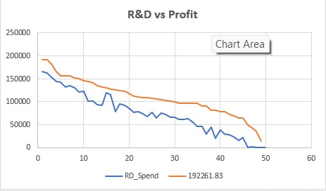
R&D v/s PROFIT
Observation:
The chart shows that both R&D spend and profit decrease over time, but profit remains consistently higher than R&D spend throughout the period.
This suggests that while R&D investment is declining, the company continues to maintain a positive profit margin during the observed period.

Slide 6
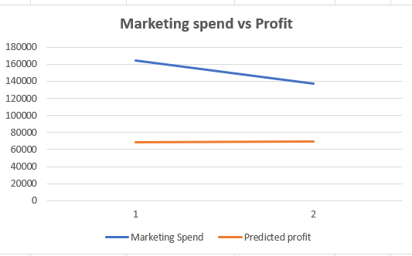
Marketing Spend v/s Profit
Observation:
The chart suggests a strong positive correlation between marketing spend and predicted profit, as both values increase significantly from point 1 to point 2.
This indicates that higher marketing investment is expected to generate substantially higher profits.

Slide 7
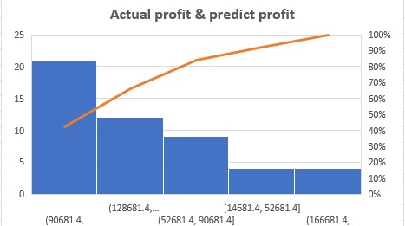
Actual profit v/s Predicted Profit
Observation:
The chart compares actual profit to predicted profit.
The wide range of Y-axis values suggests there is a significant variance between the predicted profit and the actual profit achieved, indicating that the prediction model may not be very accurate.

Slide 8
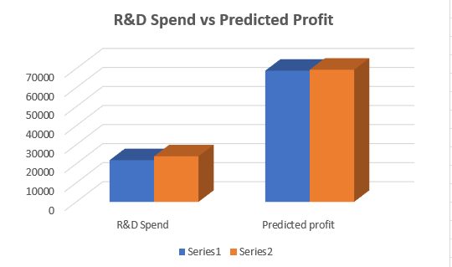
R&D v/s Predicted Profit
Observation:
The chart shows a relationship between R&D Spend and Predicted Profit for two data points.
The predicted profit appears to increase significantly from point 1 to point 2, suggesting that higher R&D spending is correlated with a higher expected profit.

Slide 9
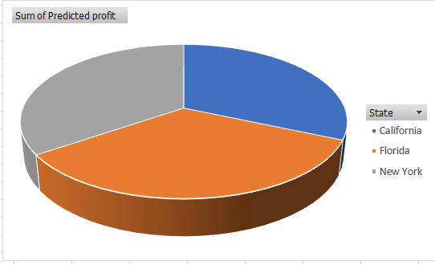
PREDICTED PROFIT BY STATE
Observation:
The wide and varied ranges on the Y-axis compared to the X-axis suggest that the actual profit values are highly scattered and do not align closely with the predicted profit.
This indicates a poor model fit and low prediction accuracy.

Slide 10
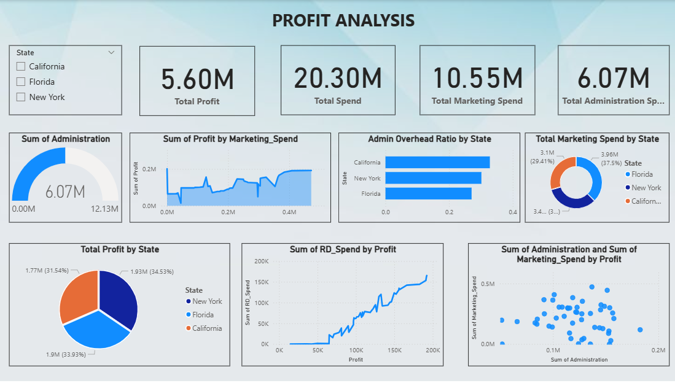

Slide 11
Key Insights & Recommendations
R&D investment has the highest contribution to profit.
Administration costs show little influence.
Marketing spend supports profitability but less than R&D.
Focus on optimizing R&D and marketing budgets for maximum profit.
Maintain model tracking with updated data for continuous improvement.

